Slide 1

ECE 4951
Lecture 5:
PID Control of Motorized Processes

Slide 2
PID Control
A closed loop (feedback) control system, generally with Single Input-Single Output (SISO)
A portion of the signal being fed back is:
  Proportional to the signal (P)
  Proportional to integral of the signal (I)
  Proportional to the derivative of the signal (D)

Slide 3
When PID Control is Used
PID control works well on SISO systems of 2nd Order, where a desired Set Point can be supplied to the system control input
PID control handles step changes to the Set Point especially well:
  Fast Rise Times
  Little or No Overshoot
  Fast settling Times
  Zero Steady State Error
PID controllers are often fine tuned on-site, using established guidelines

Slide 4
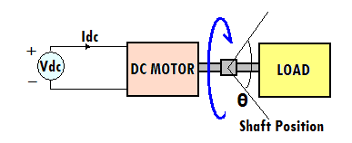
Control Theory
Consider a DC Motor turning a Load:
  Shaft Position, Theta, is proportional to the input voltage

Slide 5
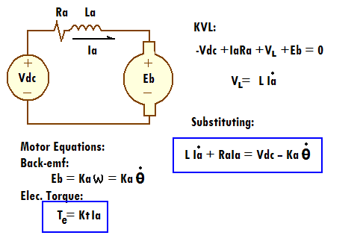
Looking at the Motor:
Electrically (for Permanent Magnet DC):

Slide 6
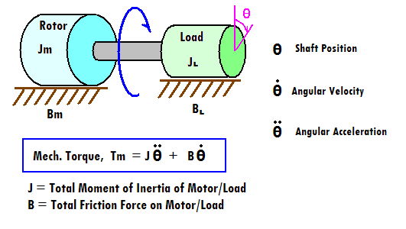
Looking at the Motor
Mechanically:

Slide 7
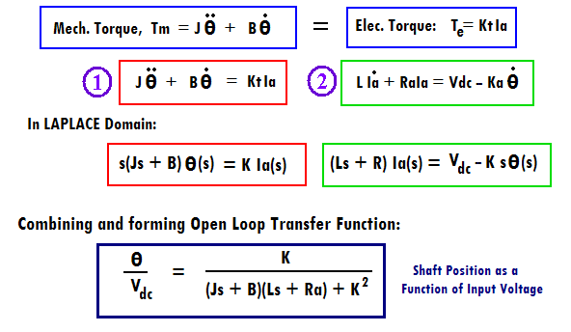
Combining Elect/Mech
Torque is Conserved: Tm = Te
1 and 2 above are a basis for the state-space description

Slide 8
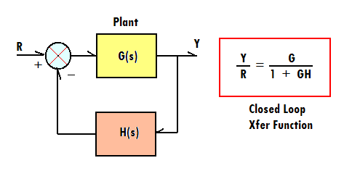
This Motor System is 2nd Order
So, the “plant”,G(s) = K / (s² + 2as + b²)
  Where a = damping factor, b = undamped freq.
And a Feedback Control System would look like:

Slide 9
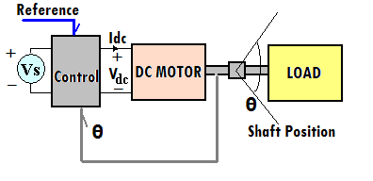
Physically, We Want:
A 2nd Order SISO System with Input to Control Shaft Position:

Slide 10
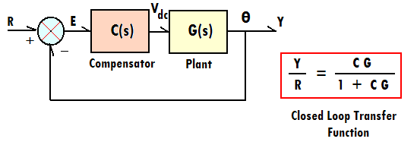
Adding the PID:
Consider the block diagram shown:
C(s) could also be second order….(PID)

Slide 11
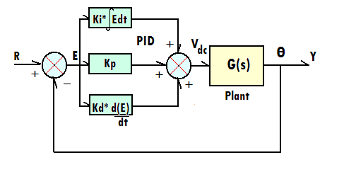
PID Block Diagram:

Slide 12
PID Mathematically:
Consider the input error variable, e(t):
  Let p(t) = Kp*e(t) {p proportional to e (mag)}
  Let i(t) = Ki*∫e(t)dt {i integral of e (area)}
  Let d(t) = Kd* de(t)/dt {d derivative of e (slope)}
  AND let Vdc(t) = p(t) + i(t) + d(t)
  Then in Laplace Domain:
  Vdc(s) = [Kp + 1/s Ki + s Kd] E(s)

Slide 13
PID Implemented:
Let C(s) = Vdc(s) / E(s) (transfer function)
C(s) = [Kp + 1/s Ki + s Kd]
= [Kp s + Ki + Kd s²] / s (2nd Order)
THEN
C(s)G(s) = K [Kd s² + Kp s + Ki]
s(s² + 2as + b²)
AND
Y/R = Kd s² + Kp s + Ki
s³ + (2a+Kd)s² + (b²+Kp) s + Ki

Slide 14
Implications:
Kd has direct impact on damping
Kp has direct impact on resonant frequency
In General the effects of increasing parameters is:
Parameter: Rise Time Overshoot Settling Time S.S.Error
Kp Decrease Increase Small Change Decrease
Ki Decrease Increase Increase Eliminate
Kd Small Change Decrease Decrease None

Slide 15
Tuning a PID:
There is a fairly standard procedure for tuning PID controllers
A good first stop for tuning information is Wikipedia:
http://en.wikipedia.org/wiki/PID_controller

Slide 16
Deadband
In noisy environments or with energy intensive processes it may be desirable to make the controller unresponsive to small changes in input or feedback signals
A deadband is an area around the input signal set point, wherein no control action will occur

Slide 17
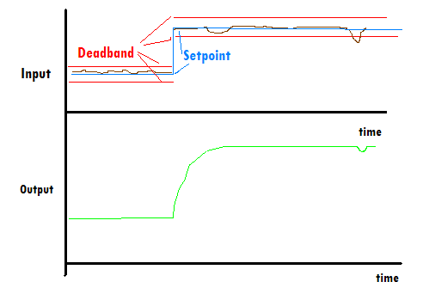

Slide 18
Time Step Implementation of Control Algorithms (digital controllers)
Given a continuous, linear time domain description of a process, it is possible to approximate the process with Difference Equations and implement in software
Time Step size (and/or Sampling Rate) is/are critical to the accuracy of the approximation

Slide 19
From Differential Equation to Difference Equation:
Definition of Derivative:
    dU = lim U(t + Δt) – U(t)
    dt Δt→0 Δt
Algebraically Manipulate to Difference Eq:
    U(t + Δt) = U(t) + Δt*dU
    dt
    (for sufficiently small Δt)
Apply this to Iteratively Solve First Order Linear Differential Equations (hold for applause)

Slide 20
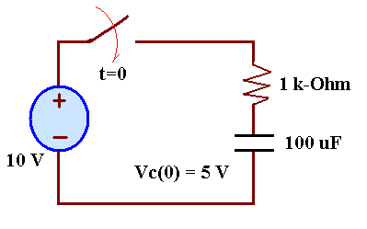
Implementing Difference Eqs:
Consider the following RC Circuit, with 5 Volts of initial charge on the capacitor:
KVL around the loop:
    -Vs + Ic*R + Vc = 0, Ic = C*dVc/dt
    OR dVc/dt = (Vs –Vc)/RC

Slide 21
Differential to Difference with
Time-Step, T:
Differential Equation:
dVc/dt = (Vs –Vc)/RC
Difference Equation by Definition:
Vc(kT+T) = Vc(kT) + T*dVc/dt
Substituting:
Vc(kT+T) = Vc(kT) + T*(Vs –Vc(kT))/RC

Slide 22
Coding in SciLab:
R=1000
C=1e-4
Vs=10
Vo=5
//Initial Value of Difference Equation (same as Vo)
Vx(1)=5
//Time Step
dt=.01
//Initialize counter and time variable
i=1
t=0
//While loop to calculate exact solution and difference equation
while i<101, Vc(i)=Vs+(Vo-Vs)*exp(-t/(R*C)),
Vx(i+1)=Vx(i)+dt*(Vs-Vx(i))/(R*C),
t=t+dt,
i=i+1,
end

Slide 23
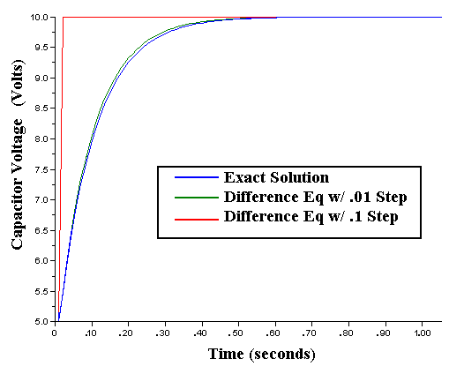
Results:

Slide 24
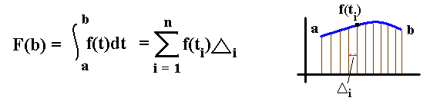
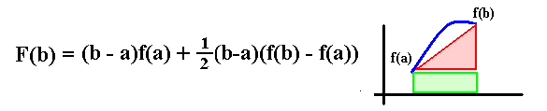
Integration by Trapezoidal Approximation:
Definition of Integration (area under curve):
Approximation by Trapezoidal Areas

Slide 25
Trapezoidal Approximate Integration in SciLab:
//Calculate and plot X=5t and integrate it with a Trapezoidal approx.
//Time Step
dt=.01
//Initialize time and counter
t=0
i=2
//Initialize function and its trapezoidal integration function
X(1)=0
Y(1)=0
//Perform time step calculation of function and trapezoidal integral
while i<101,X(i)=5*t,Y(i)=Y(i-1)+dt*X(i-1)+0.5*dt*(X(i)-X(i-1)),
t=t+dt,
i=i+1,
end
//Plot the results
plot(X)
plot(Y)

Slide 26
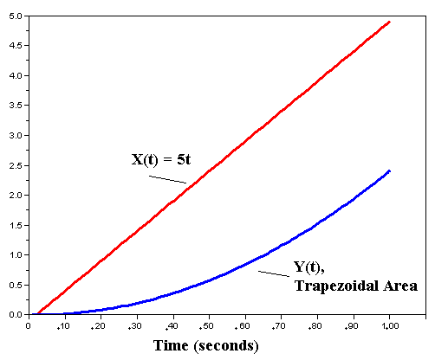
Results:

Slide 27
Coding the PID
Using Difference Equations, it is possible now to code the PID algorithm in a high level language
  p(t) = Kp*e(t) → P(kT) = Kp*E(kT)
  i(t) = Ki*∫e(t)dt →
  I(kT+T) = Ki*[I(kT)+T*E(kT+T)+.5(E(kT+T)-E(kT))]
  d(t) = Kd* de(t)/dt → D(kT+T) = Kd*[E(kT+T)-E(kT)]/T

Slide 28
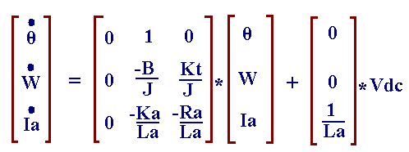
Example: Permanent Magnet DC Motor
State-Space Description of the DC Motor:
    0. θ’ = ω (angular frequency)
    1. Jθ’’ + Bθ’ = KtIa → ω’ = -Bω/J + KtIa/J
    LaIa’ + RaIa = Vdc - Kaθ’ →
    Ia’ = -Kaω/La –RaIa/La +Vdc/La
    In Matrix Form:

Slide 29
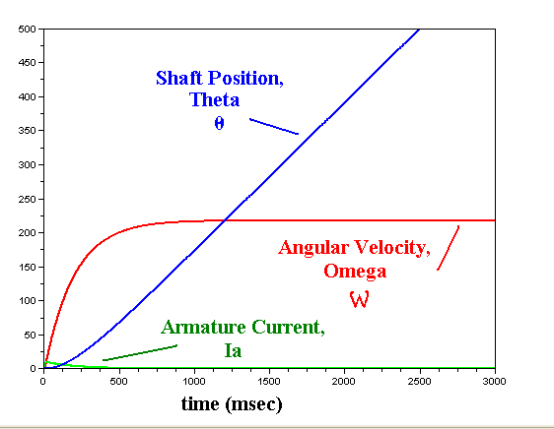
Scilab Emulation of PM DC Motor using State Space Equations

Slide 30
DC Motor with PID control
//PID position control of permanent magnet DC motor
//Constants
Ra=1.2;La=1.4e-3;Ka=.055;Kt=Ka;J=.0005;B=.01*J;Ref=0;Kp=5;Ki=1;Kd=1
//Initial Conditions
Vdc(1)=0;Theta(1)=0;Omega(1)=0;Ia(1)=0;P(1)=0;I(1)=0;D(1)=0;E(1)=0
//Time Step (Seconds)
dt=.001
//Initialize Counter and time
i=1;t(1)=0
//While loop to simulate motor and PID difference equation approximation
while i<1500, Theta(i+1)=Theta(i)+dt*Omega(i),
Omega(i+1)=Omega(i)+dt*(-B*Omega(i)+Kt*Ia(i))/J,
Ia(i+1)=Ia(i)+dt*(-Ka*Omega(i)-Ra*Ia(i)+Vdc(i))/La,
E(i+1)=Ref-Theta(i+1),
P(i+1)=Kp*E(i+1),
I(i+1)=Ki*(I(i)+dt*E(i)+0.5*dt*(E(i+1)-E(i))),
D(i+1)=Kd*(E(i+1)-E(i))/dt,
Vdc(i+1)=P(i+1)+I(i+1)+D(i+1),
//Check to see if Vdc has hit power supply limit
if Vdc(i+1)>12 then Vdc(i+1)=12
end
t(i+1)=t(i)+dt,
i=i+1,
//Call for a new shaft position
if i>5 then Ref=10
end
end

Slide 31
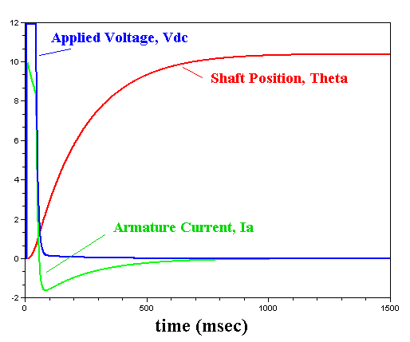
Results:

Slide 32
References:
Phillips and Nagle, Digital Control System Analysis and Design, Prentice Hall, 1995, ISBN-10: 013309832X
WAKE UP!!

